Slide 1


Presented by Group 6
FinGraph: A Knowledge Graph-Enhanced RAG Chatbot for Financial FAQs
Rakesh JV
Priyanshu Jain
Mihir Yanamandra

Slide 2


AGENDA
Abstract
Methodology
Introduction
Result
Problem
Conclusion
Objectives
Reference

Slide 3
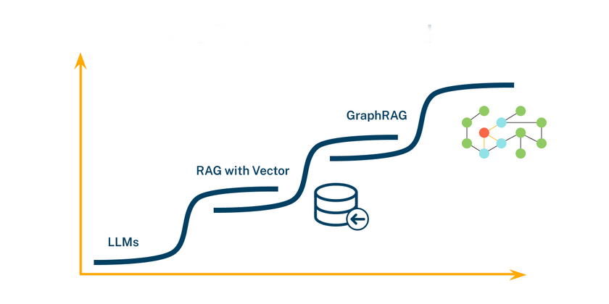
What is GraphRAG?
RAG (Retrieval-Augmented Generation) is a model that boosts response accuracy by retrieving relevant information.
GraphRAG enhances RAG by incorporating knowledge graphs that store and link related or unrelated data based on their relationships.
Architectural Innovation: Combines traditional vector storage with knowledge graph structure, creating a hybrid system for enhanced information retrieval.
Relationship-Driven Structure: Utilizes nodes, edges, and properties to capture explicit connections between information, enabling complex queries.

Slide 4

PROBLEM STATEMENT
Traditional chatbots struggle to handle complex financial queries due to limited context and lack of real-time information, resulting in inaccurate or incomplete answers that can erode user trust.
This project addresses these issues by building a financial chatbot with GraphRAG, integrating real-time data.
This approach enables the chatbot to deliver precise, context-aware responses, ensuring users receive accurate, up-to-date insights on financial topics.

Slide 5


Evolving Financial Landscape
Current Scenario:
The financial sector increasingly relies on Large Language Models (LLMs) for data analysis, insights, and decision-making.
Challenge:
Training LLMs for complex financial tasks demands substantial computational resources, especially for processing long context sequences to accurately interpret market trends and financial documents.
Sub-challenges:
Complex Data Integration: Financial data comes from various sources, requiring efficient handling of diverse formats.
Dynamic Market Conditions: Rapidly changing financial markets require LLMs to adapt continuously, demanding constant updates and retraining to maintain accuracy.

Slide 6
PROPOSED SOLUTION “FINGRAPH”
A financial chatbot model that combines real-time data retrieval, and structured knowledge graph insights, enabling users to get accurate answers to complex financial queriest
Latest News Extraction: Retrieves up-to-date financial data using NewsAPI, ensuring current information.Knowledge.
Graph Storage: Neo4j serves as the graph database, storing and structuring financial data to capture complex relationships between entities.
Conversational Interface: OpenAI’s LLMs power the chatbot interface, allowing users to ask financial questions in a natural, conversational way.

Slide 7

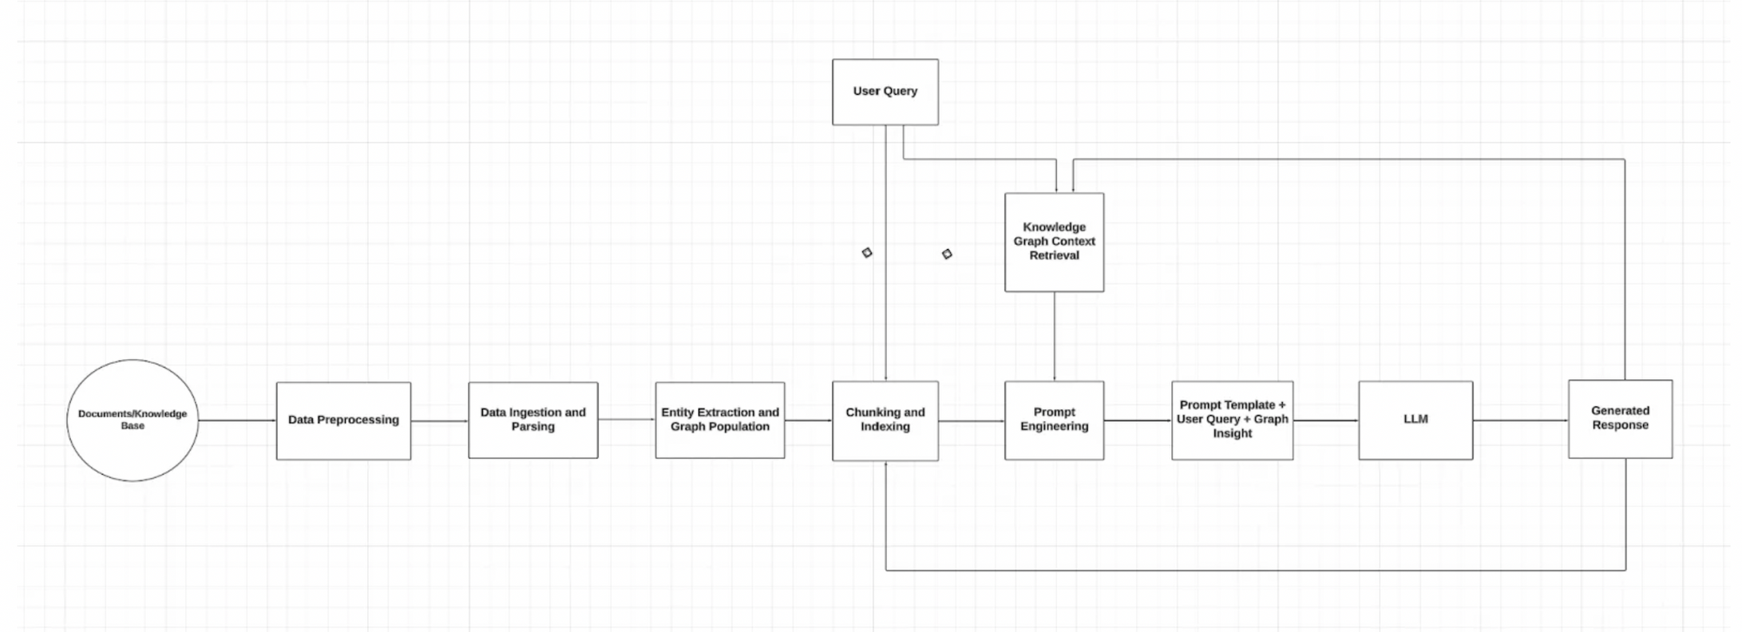
FLOWCHART

Slide 8
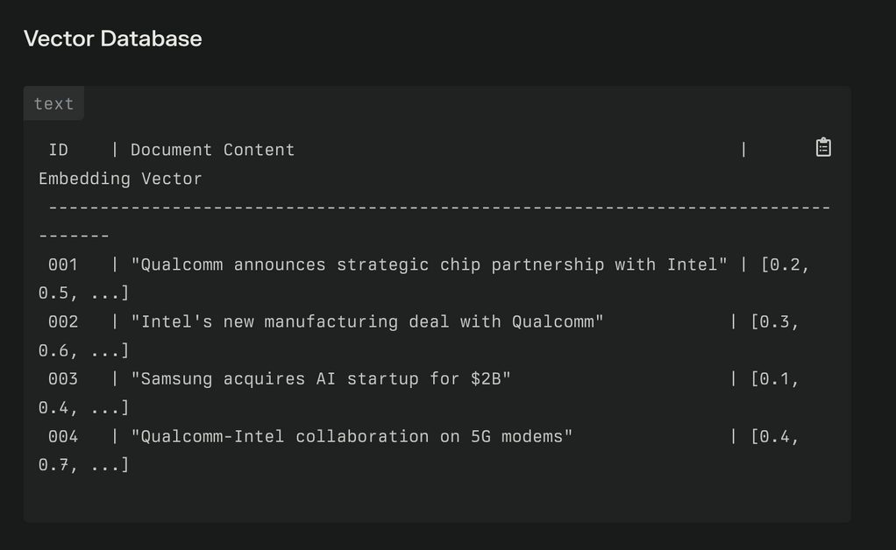
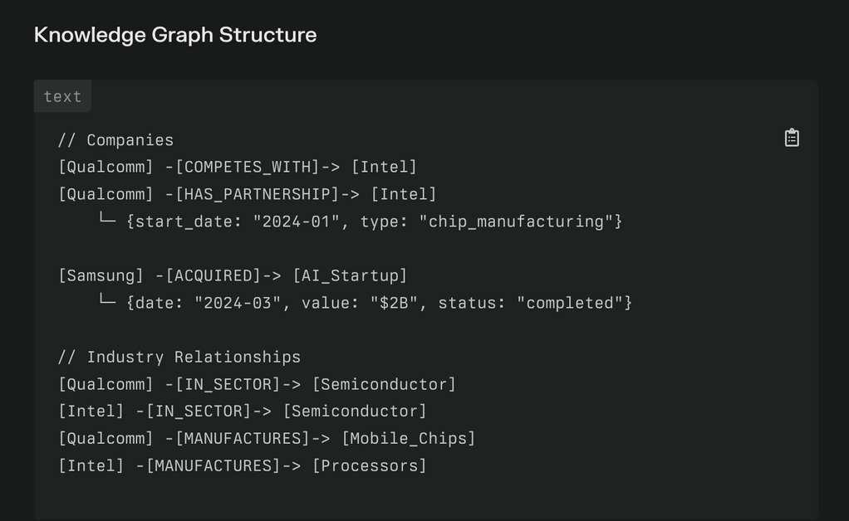
How to prepare the data for GraphRAG?
Latest news articles will be obtained via NEWS API

Slide 9
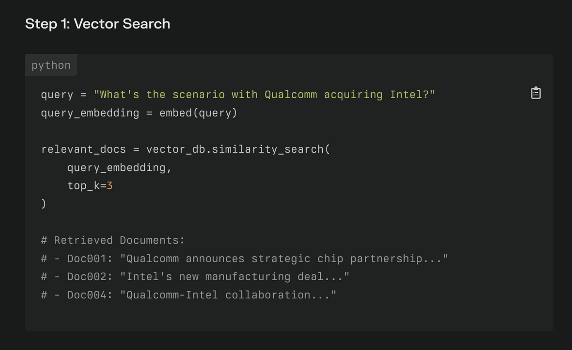
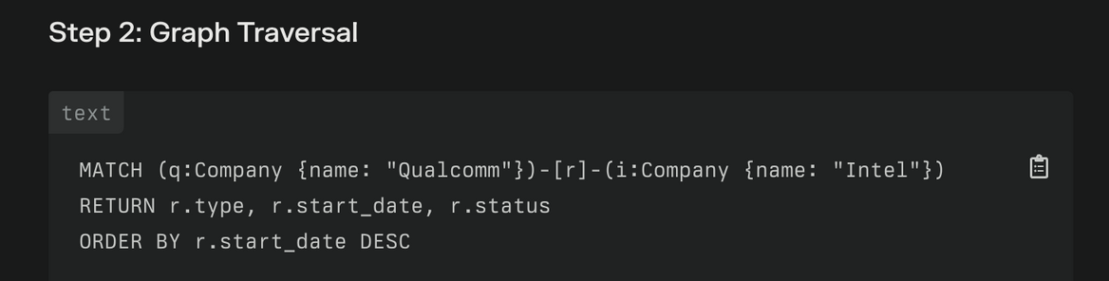
Chatting with GraphRAG model

Slide 10
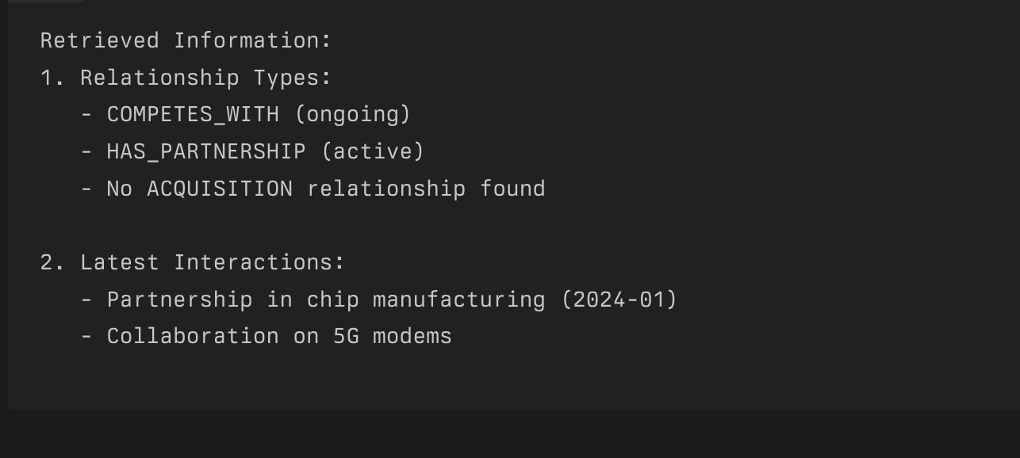
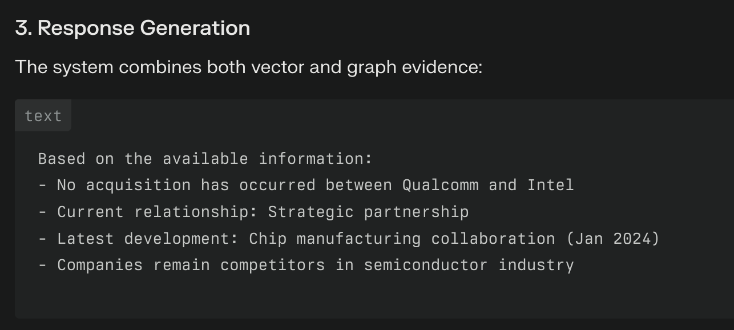
Respone Generation

Slide 11
Performance Metrics
Precision@k = Number of relevant items in the top k results
k
​
Recall@k = Number of relevant items in the top k results
Total number of relevant items

Slide 12
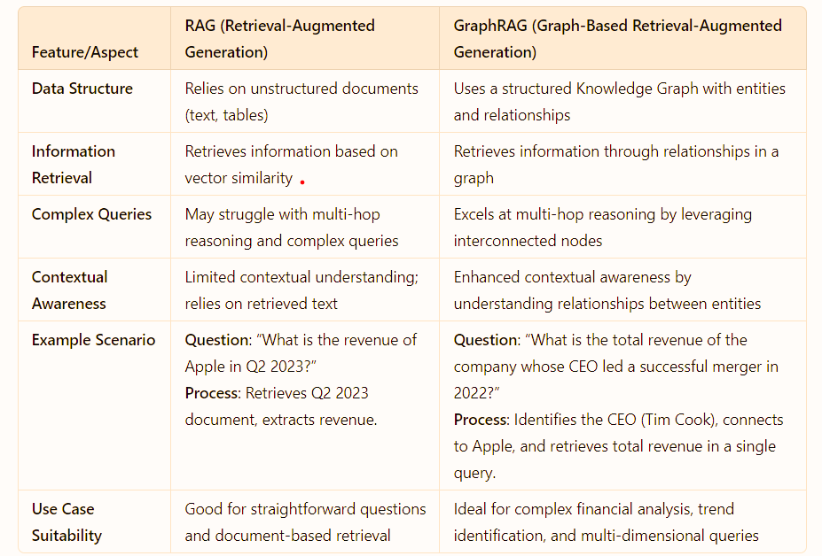
Comparison related to Past work

Slide 13
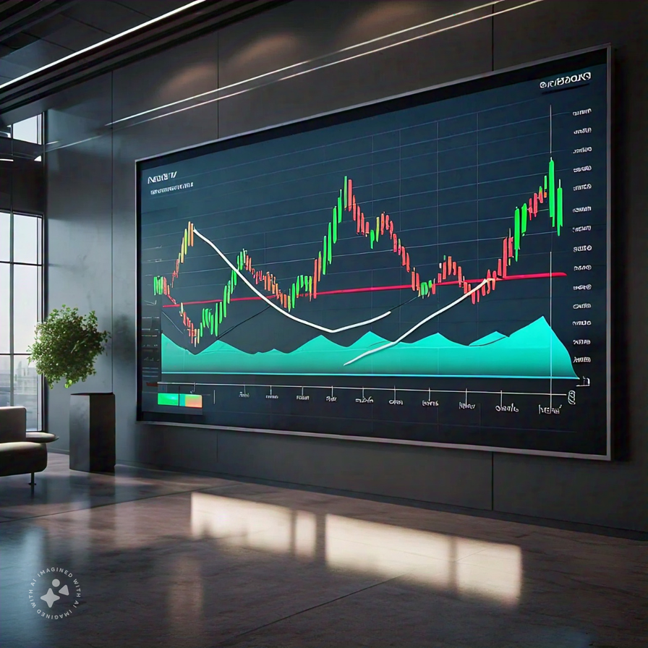
APPLICATIONS
Investment Analysis:
Enhances decision-making by analyzing relationships between companies, market trends, and economic indicators.
Market Trend Analysis:
Tracks emerging opportunities or threats by connecting financial data with sentiment from news and social media.
Portfolio Management: Helps investors make informed decisions by balancing risk and return across different assets to achieve their financial goals.

Slide 14

CHALLENGES TO ACCOMPLISH
Challenges
Data integration and interoperability
Knowledge graph maintenance and evolution
Scalability and performance
Lack of standardization
Finance Domain-specific challenges
Proposed Solution: FinGraph
Knowledge-Enhanced RAG: Utilizes a knowledge graph to enhance query understanding, allowing for precise answers to intricate questions.
Intelligent Retrieval: Pulls the latest news data via API
Context-Driven Advice

Slide 15
CONCLUSION
This project developed a financial chatbot using GraphRAG for accurate responses.
This solution enhances response precision and user trust by grounding answers in structured financial insights.
The result is a reliable, up-to-date chatbot capable of handling complex financial queries effectively.

Slide 16
REFERENCES
Ng, A., & Kollegger, A. Courses on Knowledge Graphs for RAG.
Lewis, P., et al. (2020). Retrieval-Augmented Generation for Knowledge-Intensive NLP Tasks. Proceedings of the 37th International Conference on Machine Learning.
Chen, M., et al. (2021). FinQA: A Dataset for Financial Question Answering. arXiv preprint arXiv:2102.12345.
Park, N., et al. (2022). EvoKG: Learning Dynamic Knowledge Graphs for Future Events. arXiv preprint arXiv:2203.12345

Slide 17
Thank You
For your attention

